Slide 1
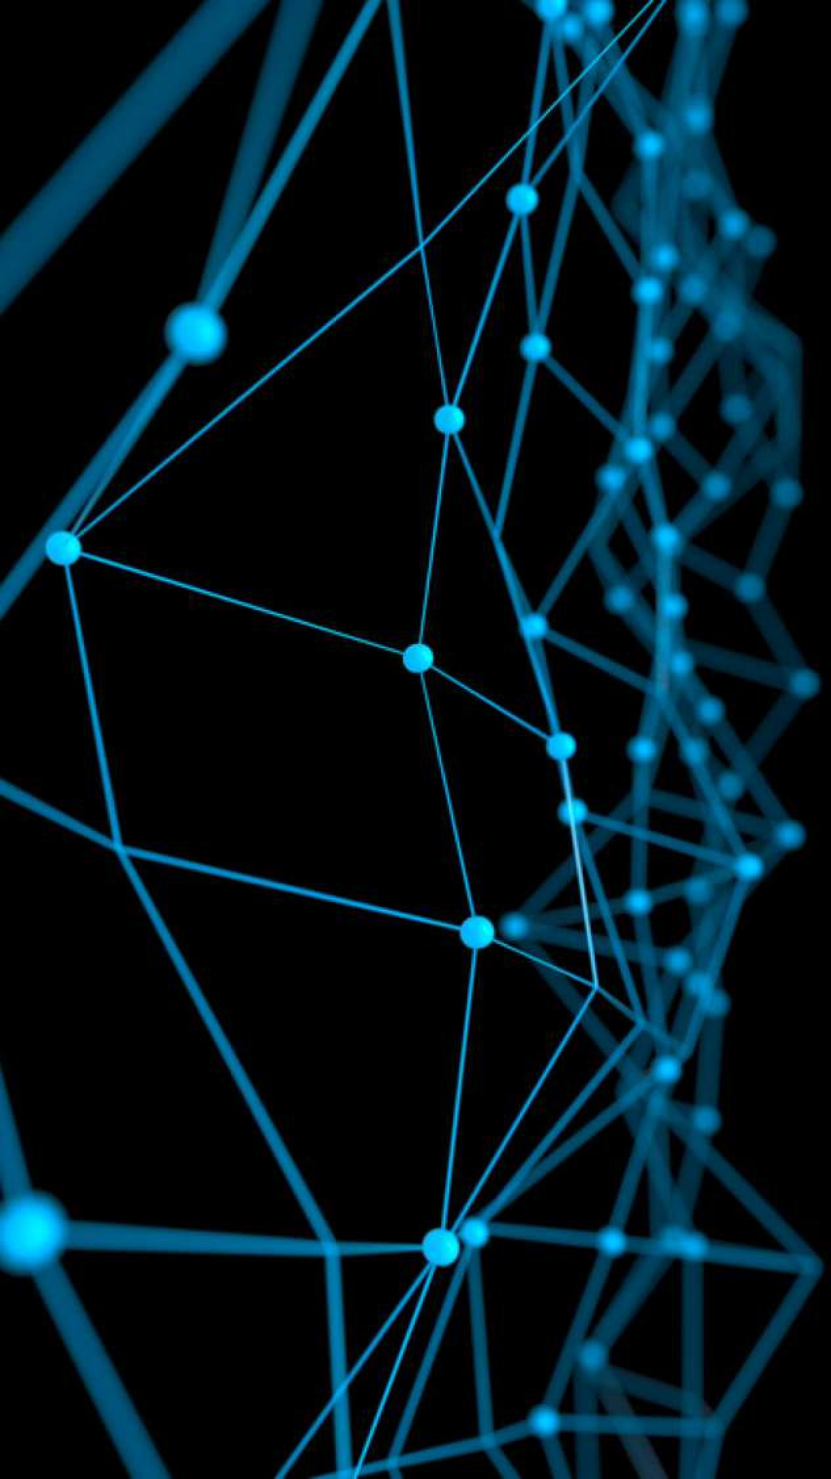
Deep Learning for Natural Language Processing:
Fancy RNNs
June 2019

Slide 2
Overview
Last lecture we learned:
Recurrent Neural Networks (RNNs) and why they’re great for Language
Modeling (LM).
Today we’ll learn:
Problems with RNNs and how to fix them
More complex RNN variants
Next lecture we’ll learn:
How we can do Neural Machine Translation (NMT) using an RNN-based
architecture called sequence-to-sequence with attention

Slide 3
Today’s lecture
Vanishing gradient problem
Two new types of RNN: LSTM and GRU
motivates
Other fixes for vanishing (or exploding) gradient:
Gradient clipping
Skip connections
Lots of important definitions today!
More fancy RNN variants:
Bidirectional RNNs
Multi-layer RNNs

Slide 4
Vanishing gradient

Slide 5








Vanishing gradient intuition

Slide 6
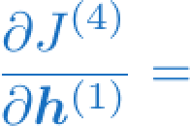
Vanishing gradient intuition
?

Slide 7




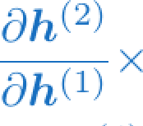
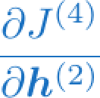
Vanishing gradient intuition
chain rule!

Slide 8
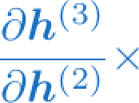
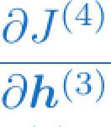
Vanishing gradient intuition
chain rule!

Slide 9
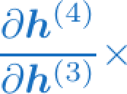
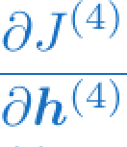
Vanishing gradient intuition
chain rule!

Slide 10
Vanishing gradient intuition
Vanishing gradient problem: When these are small, the gradient signal gets smaller and smaller as it backpropagates further
What happens if these are small?

Slide 11

Why is vanishing gradient a problem?
Gradient signal from faraway is lost because it’s much
smaller than gradient signal from close-by.
So model weights are only updated only with respect to near effects, not long-term effects.

Slide 12
Why is vanishing gradient a problem?
Another explanation: Gradient can be viewed as a measure of
the effect of the past on the future
If the gradient becomes vanishingly small over longer distances (step t to step t+n), then we can’t tell whether:
There’s no dependency between step t and t+n in the data
We have wrong parameters to capture the true dependency between t and t+n

Slide 13
Effect of vanishing gradient on RNN-LM
LM task: When she tried to print her tickets, she found that the printer was out of toner. She went to the stationery store to buy more toner. It was very overpriced. After installing the toner into the printer, she finally printed her
To learn from this training example, the RNN-LM needs to model the dependency between “tickets” on the 7th step and the target word “tickets” at the end.
But if gradient is small, the model can’t learn this dependency
So the model is unable to predict similar long-distance dependencies at test time

Slide 14
Effect of vanishing gradient on RNN-LM
LM task: The writer of the books is
are
Correct answer: The writer of the books is planning a sequel
Syntactic recency: The writer of the books is (correct)
Sequential recency: The writer of the books are (incorrect)
Due to vanishing gradient, RNN-LMs are better at learning from sequential recency than syntactic recency, so they make this
type of error more often than we’d like [Linzen et al 2016]
“Assessing the Ability of LSTMs to Learn Syntax-Sensitive Dependencies”, Linzen et al, 2016. https://arxiv.org/pdf/1611.01368.pdf

Slide 15
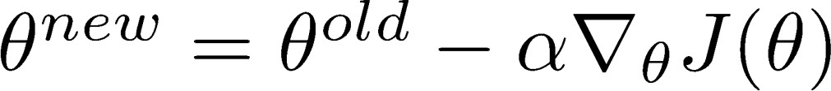
Why is exploding gradient a problem?
If the gradient becomes too big, then the SGD update step becomes too big:
learning rate
gradient
This can cause bad updates: we take too large a step and reach a bad parameter configuration (with large loss)
In the worst case, this will result in Inf or NaN in your network (then you have to restart training from an earlier checkpoint)

Slide 16
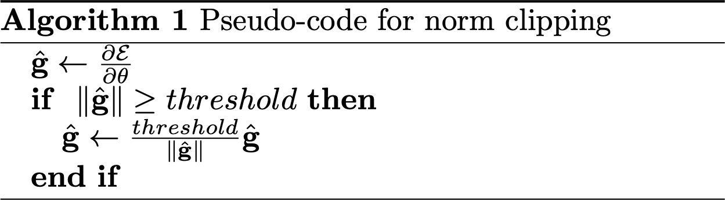
Gradient clipping: solution for exploding gradient
Gradient clipping: if the norm of the gradient is greater than some threshold, scale it down before applying SGD update
Intuition: take a step in the same direction, but a smaller step
Source: “On the difficulty of training recurrent neural networks”, Pascanu et al, 2013. http://proceedings.mlr.press/v28/pascanu13.pdf

Slide 17
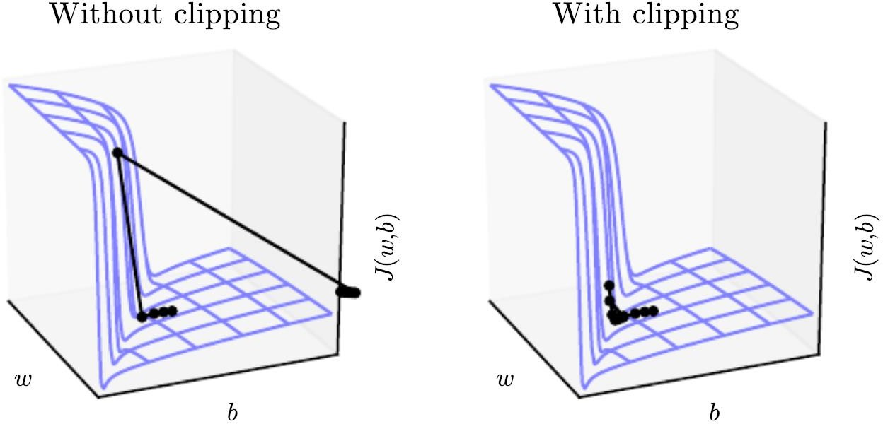
Gradient clipping: solution for exploding gradient
This shows the loss surface of a simple RNN (hidden state is a scalar not a vector)
The “cliff” is dangerous because it has steep gradient
On the left, gradient descent takes two very big steps due to steep gradient, resulting in climbing the cliff then shooting off to the right (both bad updates)
On the right, gradient clipping reduces the size of those steps, so effect is less drastic
Source: “Deep Learning”, Goodfellow, Bengio and Courville, 2016. Chapter 10.11.1. https://www.deeplearningbook.org/contents/rnn.html

Slide 18
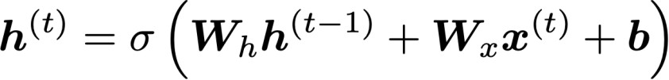
How to fix vanishing gradient problem?
The main problem is that it’s too difficult for the RNN to learn to preserve information over many timesteps.
In a vanilla RNN, the hidden state is constantly being rewritten
How about a RNN with separate memory?

Slide 19
Long Short-Term Memory (LSTM)

Slide 20


Long Short-Term Memory (LSTM)
A type of RNN proposed by Hochreiter and Schmidhuber in 1997 as a
solution to the vanishing gradients problem.
On step t, there is a hidden state and a cell state
Both are vectors length n
The cell stores long-term information
The LSTM can erase, write and read information from the cell
The selection of which information is erased/written/read is controlled by three corresponding gates
The gates are also vectors length n
On each timestep, each element of the gates can be open (1), closed (0), or somewhere in-between.
The gates are dynamic: their value is computed based on the current context
“Long short-term memory”, Hochreiter and Schmidhuber, 1997. https://www.bioinf.jku.at/publications/older/2604.pdf

Slide 21


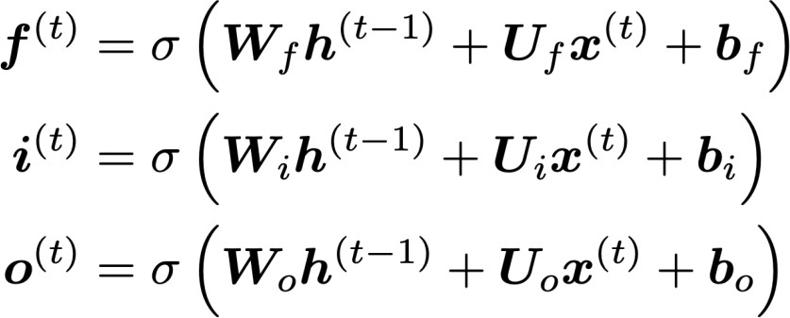
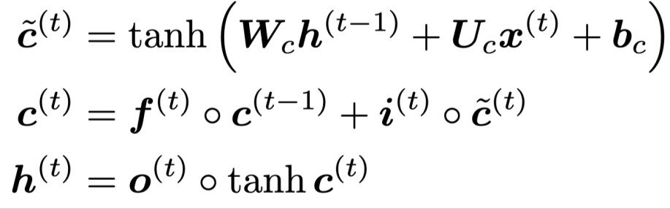
Long Short-Term Memory (LSTM)
We have a sequence of inputs , and we will compute a sequence of hidden states and cell states . On timestep t:
Sigmoid function: all gate values are between 0 and 1
Forget gate: controls what is kept vs forgotten, from previous cell state
Input gate: controls what parts of the new cell content are written to cell
All these are vectors of same length n
Output gate: controls what parts of cell are output to hidden state
New cell content: this is the new content to be written to the cell
Cell state: erase (“forget”) some content from last cell state, and write (“input”) some new cell content
Hidden state: read (“output”) some content from the cell
Gates are applied using element-wise product

Slide 22
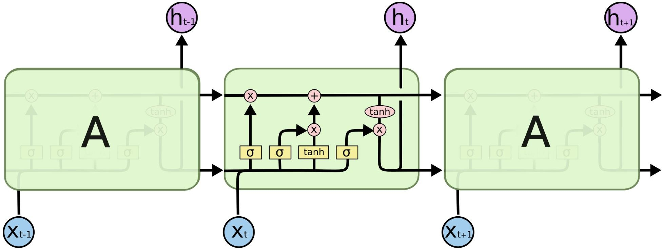
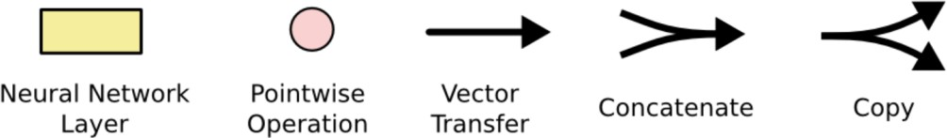
Long Short-Term Memory (LSTM)
You can think of the LSTM equations visually like this:
Source: http://colah.github.io/posts/2015-08-Understanding-LSTMs/

Slide 23
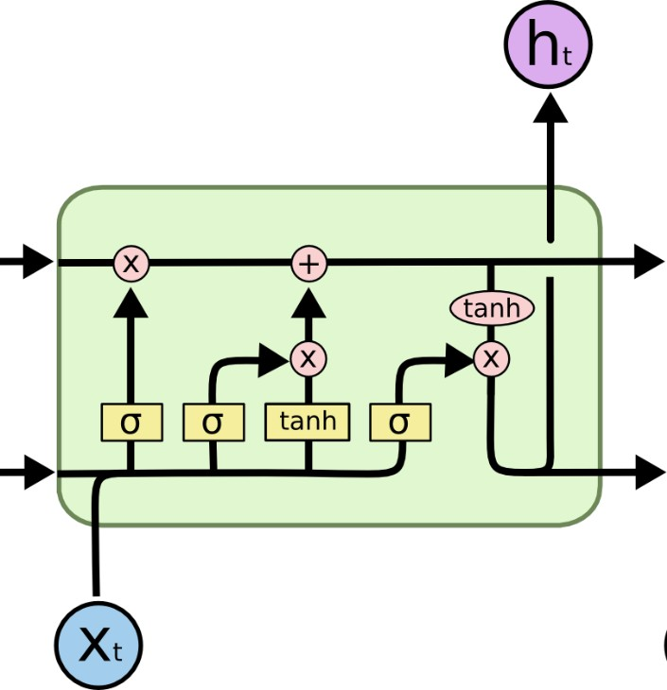
Long Short-Term Memory (LSTM)
You can think of the LSTM equations visually like this:
Write some new cell content
Forget some
cell content
c_{t}
c_{t}
^{c}t-1
f
i_{t}
o_{t}
Output some cell content to the hidden state
Compute the forget gate
t
~_{c}
t
^{h}t-1
h_{t}
Compute the input gate
Compute the new cell content
Compute the output gate
Source: http://colah.github.io/posts/2015-08-Understanding-LSTMs/

Slide 24
How does LSTM solve vanishing gradients?
The LSTM architecture makes it easier for the RNN to preserve information over many timesteps
e.g. if the forget gate is set to remember everything on every timestep, then the info in the cell is preserved indefinitely
By contrast, it’s harder for vanilla RNN to learn a recurrent
weight matrix W_{h} that preserves info in hidden state
LSTM doesn’t guarantee that there is no vanishing/exploding gradient, but it does provide an easier way for the model to learn long-distance dependencies

Slide 25
LSTMs: real-world success
In 2013-2015, LSTMs started achieving state-of-the-art results
Successful tasks include: handwriting recognition, speech recognition, machine translation, parsing, image captioning
LSTM became the dominant approach
Now (2019), other approaches (e.g. Transformers) have become more dominant for certain tasks.
For example in WMT (a MT conference + competition):
In WMT 2016, the summary report contains ”RNN” 44 times
In WMT 2018, the report contains “RNN” 9 times and
“Transformer” 63 times
Source: "Findings of the 2016 Conference on Machine Translation (WMT16)", Bojar et al. 2016, http://www.statmt.org/wmt16/pdf/W16-2301.pdf
Source: "Findings of the 2018 Conference on Machine Translation (WMT18)", Bojar et al. 2018, http://www.statmt.org/wmt18/pdf/WMT028.pdf

Slide 26
Gated Recurrent Units (GRU)

Slide 27
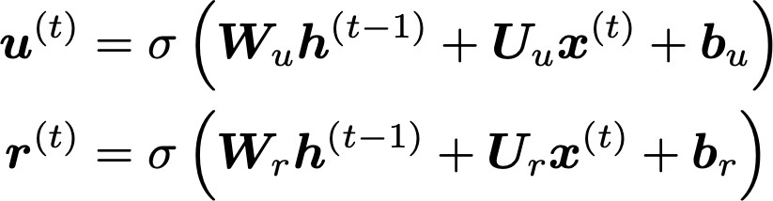
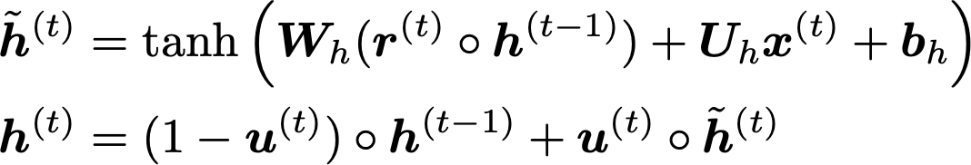
Gated Recurrent Units (GRU)
Proposed by Cho et al. in 2014 as a simpler alternative to the LSTM.
On each timestep t we have input and hidden state (no cell state).
Update gate: controls what parts of hidden state are updated vs preserved
Reset gate: controls what parts of previous hidden state are used to compute new content
New hidden state content: reset gate selects useful parts of prev hidden state. Use this and current input to compute new hidden content.
Hidden state: update gate simultaneously controls what is kept from previous hidden state, and what is updated to new hidden state content
How does this solve vanishing gradient? Like LSTM, GRU makes it easier to retain info long-term (e.g. by setting update gate to 0)
"Learning Phrase Representations using RNN Encoder–Decoder for Statistical Machine Translation", Cho et al. 2014, https://arxiv.org/pdf/1406.1078v3.pdf

Slide 28
LSTM vs GRU
Researchers have proposed many gated RNN variants, but LSTM and GRU are the most widely-used
The biggest difference is that GRU is quicker to compute and has fewer parameters
There is no conclusive evidence that one consistently performs better than the other
LSTM is a good default choice (especially if your data has particularly long dependencies, or you have lots of training data)
Rule of thumb: start with LSTM, but switch to GRU if you want something more efficient
Christopher Manning & Abigail See

Slide 29
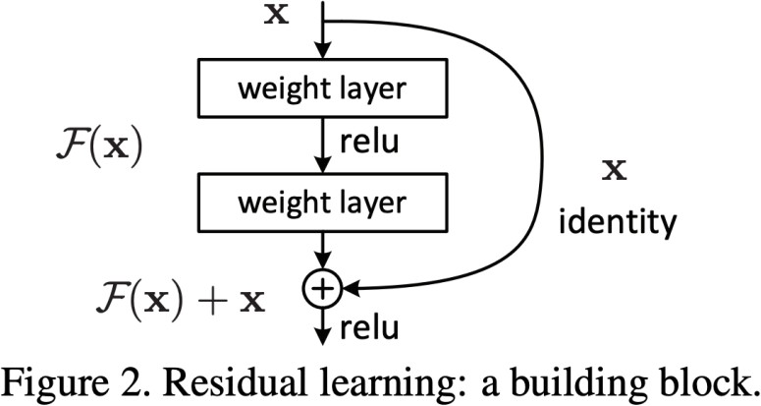
Is vanishing/exploding gradient just a RNN problem?
No! It can be a problem for all neural architectures (including feed-forward and convolutional), especially deep ones.
Due to chain rule / choice of nonlinearity function, gradient can become vanishingly small as it backpropagates
Thus lower layers are learnt very slowly (hard to train)
Solution: lots of new deep feedforward/convolutional architectures that
add more direct connections (thus allowing the gradient to flow)
For example:
Residual connections aka “ResNet”
Also known as skip-connections
The identity connection preserves information by default
This makes deep networks much
easier to train
"Deep Residual Learning for Image Recognition", He et al, 2015. https://arxiv.org/pdf/1512.03385.pdf

Slide 30
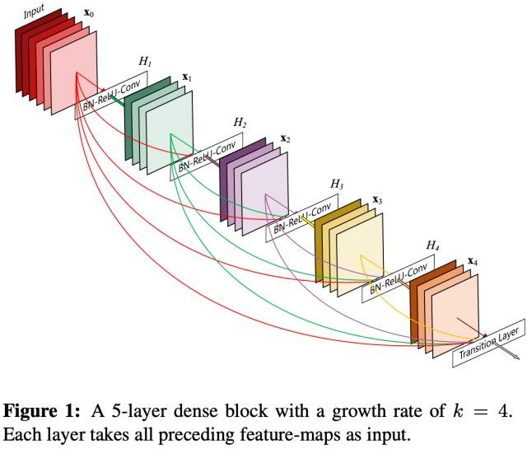
Is vanishing/exploding gradient just a RNN problem?
No! It can be a problem for all neural architectures (including feed-forward and convolutional), especially deep ones.
Due to chain rule / choice of nonlinearity function, gradient can become vanishingly small as it backpropagates
Thus lower layers are learnt very slowly (hard to train)
Solution: lots of new deep feedforward/convolutional architectures that
add more direct connections (thus allowing the gradient to flow)
For example:
Dense connections aka “DenseNet”
Directly connect everything to everything!
”Densely Connected Convolutional Networks", Huang et al, 2017. https://arxiv.org/pdf/1608.06993.pdf

Slide 31
Is vanishing/exploding gradient just a RNN problem?
No! It can be a problem for all neural architectures (including feed-forward and convolutional), especially deep ones.
Due to chain rule / choice of nonlinearity function, gradient can become vanishingly small as it backpropagates
Thus lower layers are learnt very slowly (hard to train)
Solution: lots of new deep feedforward/convolutional architectures that
add more direct connections (thus allowing the gradient to flow)
For example:
Highway connections aka “HighwayNet”
Similar to residual connections, but the identity connection vs the transformation layer is controlled by a dynamic gate
Inspired by LSTMs, but applied to deep feedforward/convolutional networks
”Highway Networks", Srivastava et al, 2015. https://arxiv.org/pdf/1505.00387.pdf

Slide 32
Is vanishing/exploding gradient just a RNN problem?
No! It can be a problem for all neural architectures (including feed-forward and convolutional), especially deep ones.
Due to chain rule / choice of nonlinearity function, gradient can become vanishingly small as it backpropagates
Thus lower layers are learnt very slowly (hard to train)
Solution: lots of new deep feedforward/convolutional architectures that
add more direct connections (thus allowing the gradient to flow)

Slide 33
Is vanishing/exploding gradient just a RNN problem?
No! It can be a problem for all neural architectures (including feed-forward and convolutional), especially deep ones.
Due to chain rule / choice of nonlinearity function, gradient can become vanishingly small as it backpropagates
Thus lower layers are learnt very slowly (hard to train)
Solution: lots of new deep feedforward/convolutional architectures that
add more direct connections (thus allowing the gradient to flow)
Conclusion: Though vanishing/exploding gradients are a general problem, RNNs are particularly unstable due to the repeated multiplication by the same weight matrix [Bengio et al, 1994]
”Learning Long-Term Dependencies with Gradient Descent is Difficult", Bengio et al. 1994, http://ai.dinfo.unifi.it/paolo//ps/tnn-94-gradient.pdf

Slide 34
Recap
Today we’ve learnt:
Vanishing gradient problem: what it is, why it happens, and
why it’s bad for RNNs
LSTMs and GRUs: more complicated RNNs that use gates to control information flow; they are more resilient to vanishing gradients
Remainder of this lecture:
Bidirectional RNNs
Multi-layer RNNs
Both of these are
pretty simple
Christopher Manning & Abigail See

Slide 35
Bidirectional RNNs

Slide 36

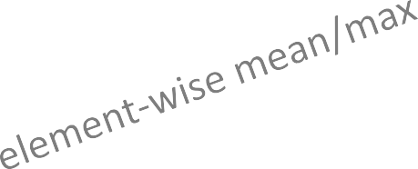
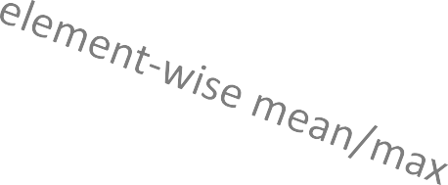
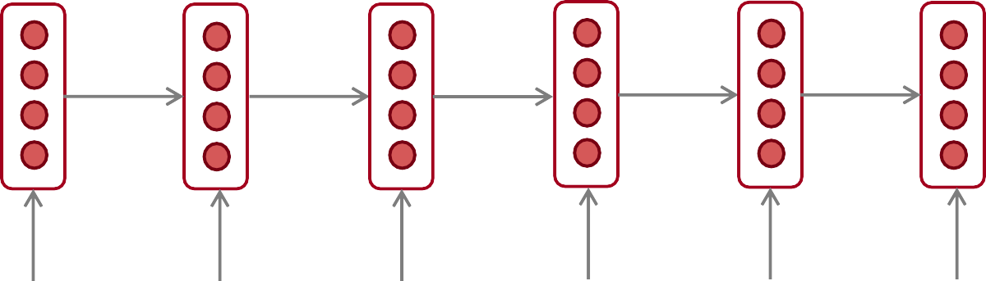
Bidirectional RNNs: motivation
Task: Sentiment Classification
positive
We can regard this hidden state as a
representation of the word “terribly” in the context of this sentence. We call this a contextual representation.
Sentence encoding
These contextual representations only contain information about the left context (e.g. “the movie
was”).
What about right
context?
In this example, “exciting” is in the right context and this modifies the meaning of “terribly” (from negative to positive)
the
movie
was
terribly
exciting
!
Christopher Manning & Abigail See

Slide 37
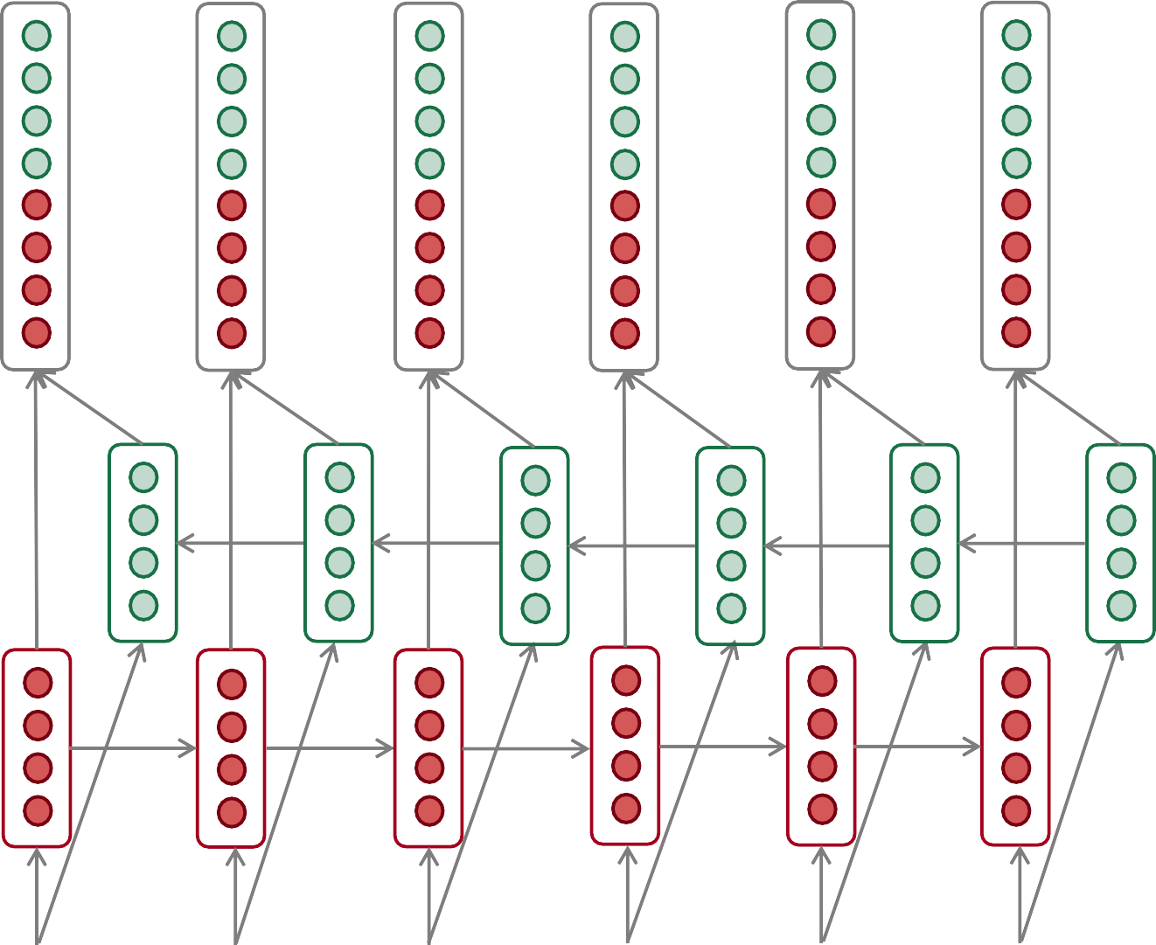
Bidirectional RNNs
This contextual representation of “terribly”
has both left and right context!
Concatenated hidden states
Backward RNN
Forward RNN
the
movie
was
terribly
exciting
!
Christopher Manning & Abigail See

Slide 38
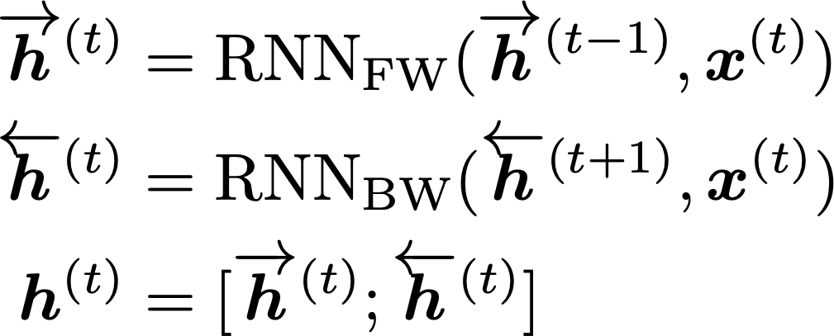
Bidirectional RNNs
On timestep t:
This is a general notation to mean “compute one forward step of the RNN” – it could be a vanilla, LSTM or GRU computation.
Forward RNN
Generally, these two RNNs have separate weights
Backward RNN
Concatenated hidden states
We regard this as “the hidden state” of a bidirectional RNN. This is what we pass on to the next parts of the network.

Slide 39
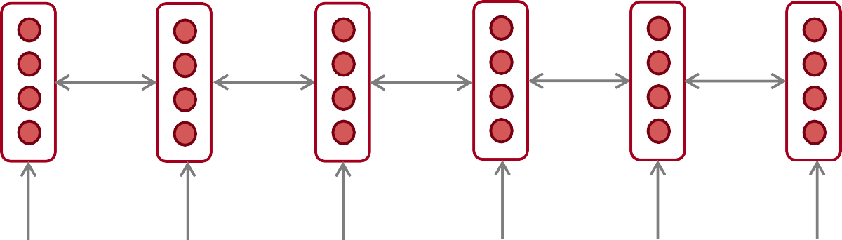
Bidirectional RNNs: simplified diagram
the
movie
was
terribly
exciting
!
The two-way arrows indicate bidirectionality and the depicted hidden states are assumed to be the concatenated forwards+backwards states.

Slide 40
Bidirectional RNNs
Note: bidirectional RNNs are only applicable if you have access to the entire input sequence.
They are not applicable to Language Modeling, because in LM you only have left context available.
If you do have entire input sequence (e.g. any kind of encoding), bidirectionality is powerful (you should use it by default).
For example, BERT (Bidirectional Encoder Representations from Transformers) is a powerful pretrained contextual representation system built on bidirectionality.

Slide 41
Multi-layer RNNs

Slide 42
Multi-layer RNNs
RNNs are already “deep” on one dimension (they unroll over
many timesteps)
We can also make them “deep” in another dimension by
applying multiple RNNs – this is a multi-layer RNN.
This allows the network to compute more complex representations
The lower RNNs should compute lower-level features and the
higher RNNs should compute higher-level features.
Multi-layer RNNs are also called stacked RNNs.

Slide 43
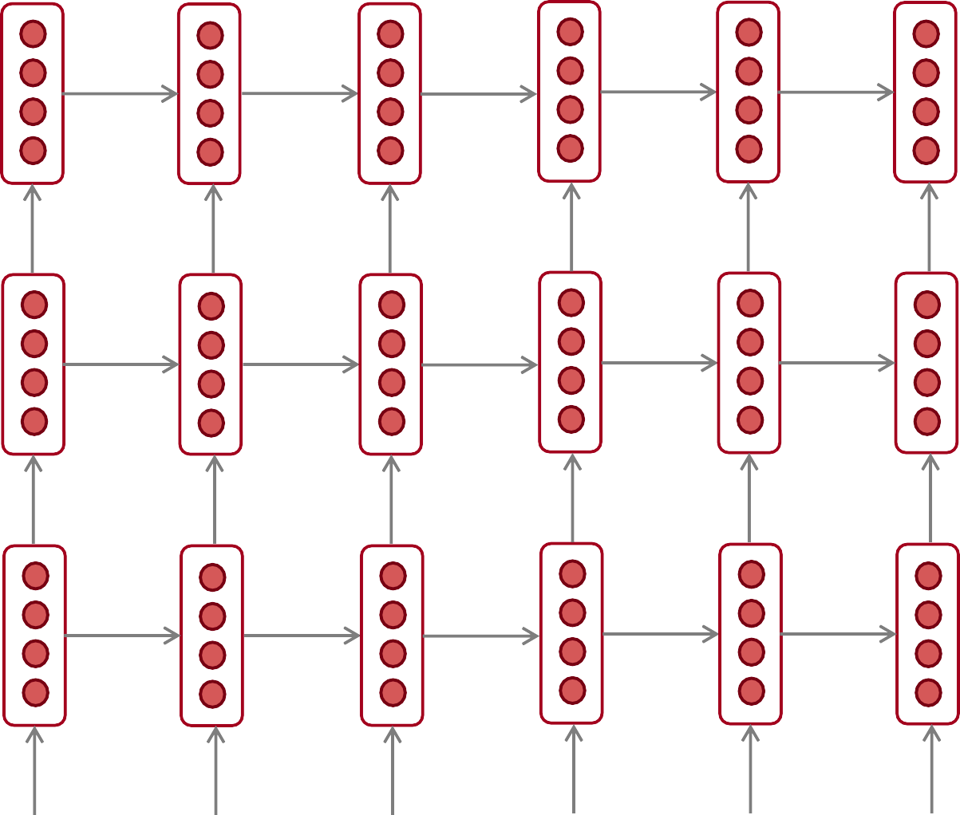
Multi-layer RNNs
RNN layer 3
The hidden states from RNN layer i
are the inputs to RNN layer i+1
RNN layer 2
RNN layer 1
the
movie
was
terribly
exciting
!

Slide 44
Multi-layer RNNs in practice
High-performing RNNs are often multi-layer (but aren’t as deep
as convolutional or feed-forward networks)
For example: In a 2017 paper, Britz et al find that for Neural Machine Translation, 2 to 4 layers is best for the encoder RNN, and 4 layers is best for the decoder RNN
However, skip-connections/dense-connections are needed to train deeper RNNs (e.g. 8 layers)
Transformer-based networks (e.g. BERT) can be up to 24 layers
You will learn about Transformers later; they have a lot of skipping-like connections
“Massive Exploration of Neural Machine Translation Architecutres”, Britz et al, 2017. https://arxiv.org/pdf/1703.03906.pdf

Slide 45
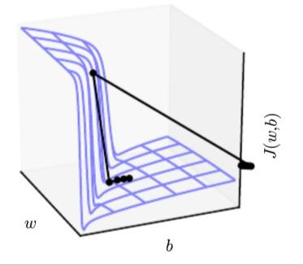
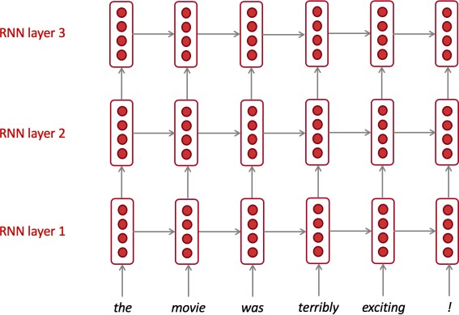
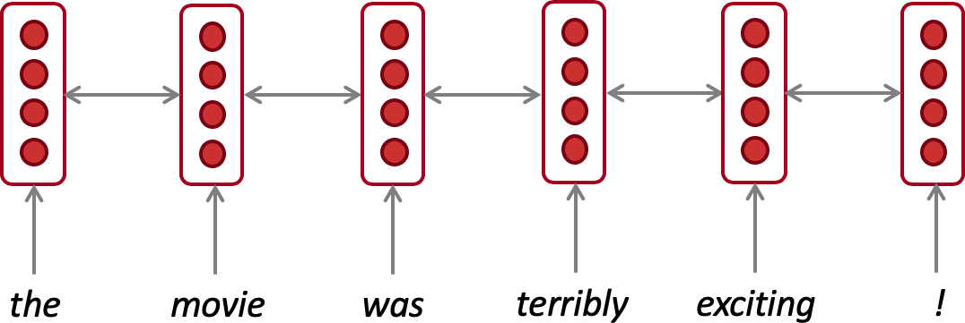
In summary
Lots of new information today! What are the practical takeaways?
1. LSTMs are powerful but GRUs are faster
2. Clip your gradients
3. Use bidirectionality when possible
4. Multi-layer RNNs are powerful, but you might need skip/dense-connections if it’s deep

